Slide 1

System analysis and design Design Patterns
Supervisors: Prof. Nguyễn Thị Thu Trang
Presenter: Tạ Hữu Bình
StudentID: 20190094

Slide 2
Content
Observer pattern
Iterator pattern

Slide 3
Content
Observer pattern
Iterator pattern

Slide 4
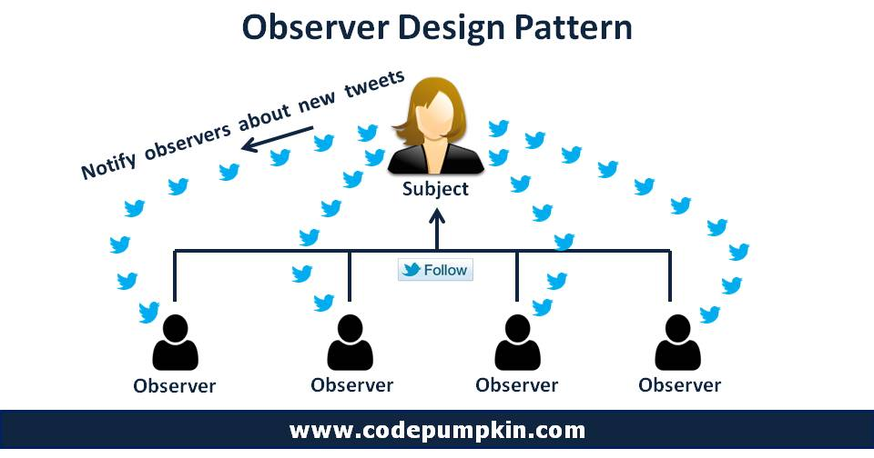
Observer pattern
Name – Alias: Observer (Publish-Subscribe) Pattern.
Classification: Behavioral patterns.
Intent: defines a subscription mechanism to notify multiple objects about any events that happen to the object they’re observing.

Slide 5
Observer pattern - Motivation
Subject can spam information to all observers.
Observers can check information of Subject again and again.
Conflict: Either observers waste time checking new information or subject wastes resources notifying the wrong customers.

Slide 6
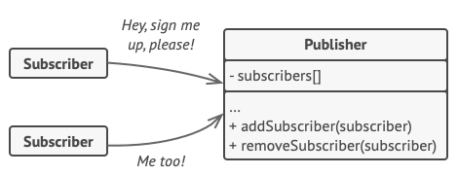
Observer pattern - Solution
An array field for storing a list of references to subscriber objects.
Several public methods which allow adding subscribers to and removing them from that list.

Slide 7
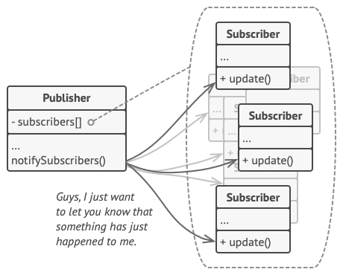
Observer pattern - Solution
Whenever an important event happens to the publisher, it goes over its subscribers and calls the specific notification method on their objects.

Slide 8
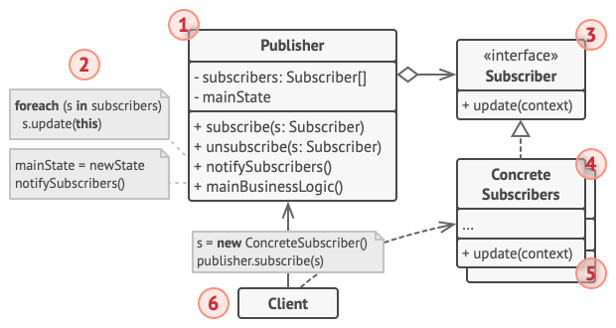
Observer pattern - Solution
1. The Publisher issues events of interest to other objects. Publishers contain a subscription infrastructure that lets new subscribers join and current subscribers leave the list.
2. When a new event happens, the publisher goes over the subscription list and calls the notification method declared in the subscriber interface on each subscriber object.

Slide 9
Observer pattern - Solution
3. The Subscriber interface declares the notification interface, let the publisher pass some event details along with the update.
4. Concrete Subscribers perform some actions in response to notifications issued by the publisher.

Slide 10
Observer pattern - Solution
5. Publishers often pass some context data as arguments of the notification method. The publisher can pass itself as an argument, letting subscriber fetch any required data directly.
6. The Client creates publisher and subscriber objects separately and then registers subscribers for publisher updates.

Slide 11
Observer pattern – Pros and cons
+ Open/Closed Principle. We can introduce new subscriber classes without having to change the publisher’s code (and vice versa if there’s a publisher interface).
+ We can establish relations between objects at runtime.
- Subscribers are notified in random order.

Slide 12
Applicability
Use the Observer pattern when changes to the state of one object may require changing other objects, and the actual set of objects is unknown beforehand or changes dynamically
Use the pattern when some objects in our app must observe others, but only for a limited time or in specific cases
Illustrated source code:
https://github.com/Tahuubinh/TKXDPM.CNTN.20221-20190094.TaHuuBinh/tree/release/lab07/Design%20Pattern/src/Observer_Pattern

Slide 13
Content
Observer pattern
Iterator pattern

Slide 14
Iterator pattern
Name – Alias: Iterator (Cursor) Pattern.
Classification: Behavioral patterns.
Iterator helps traverse elements of a collection without exposing its underlying representation (list, stack, tree, etc.).

Slide 15
Iterator pattern - Motivation
Collections are one of the most used data types in programming, some of them are based on stacks, trees, graphs, etc.
Each data structure has different ways to traverse elements → primary responsibility?

Slide 16
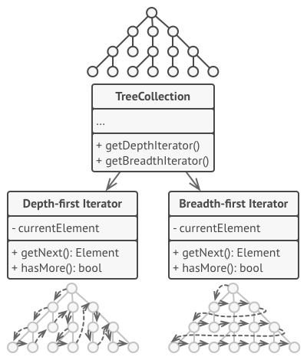
Observer pattern - Solution
The main is to extract the traversal behavior of a collection into a separate object called an iterator.
An iterator object encapsulates all of the traversal details..
Usually, iterators provide one primary method for fetching elements of the collection. The client can keep running this method until nothing returns.
All iterators must implement the same interface, can create new iterator class.

Slide 17
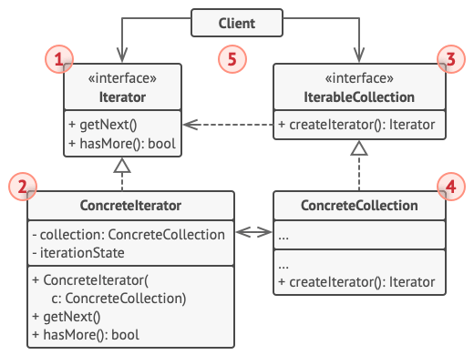
Iterator pattern - Solution
1. The Iterator interface declares the operations required for traversing a collection: fetching the next element, retrieving the current position, restarting iteration, etc.
2. Concrete Iterators implement specific algorithms for traversing a collection.

Slide 18
Iterator pattern - Solution
3. The Collection interface declares one or multiple methods for getting iterators compatible with the collection. Note that the return type of the methods must be declared as the iterator interface so that the concrete collections can return various kinds of iterators.

Slide 19
Iterator pattern - Solution
4. Concrete Collections return new instances of a particular concrete iterator class each time the client requests one. We might be wondering, where’s the rest of the collection’s code? Don’t worry, it should be in the same class. It’s just that these details aren’t crucial to the actual pattern, so we’re omitting them.

Slide 20
Iterator pattern - Solution
5. The Client works with both collections and iterators via their interfaces. This way the client isn’t coupled to concrete classes, allowing us to use various collections and iterators with the same client code.

Slide 21
Observer pattern – Pros and cons
Single Responsibility Principle. We can clean up the collections by extracting bulky traversal algorithms into separate classes.
Open/Closed Principle. We can implement new types of collections and iterators.
We can iterate over the same collection in parallel because each iterator object contains its own iteration state.
For the same reason, we can delay an iteration and continue it when needed.
Applying the pattern can be an overkill if wer app only works with simple collections.
Using an iterator may be less efficient than going through elements of some specialized collections directly.

Slide 22
Applicability
Use the Iterator pattern when our collection has a complex data structure under the hood, but we want to hide its complexity
Use the pattern to reduce duplication of the traversal code across our app
Use the Iterator when we want our code to be able to traverse different data structures or when types of these structures are unknown beforehand
Illustrated source code:
https://github.com/Tahuubinh/TKXDPM.CNTN.20221-20190094.TaHuuBinh/tree/release/lab07/Design%20Pattern/src/Iterator_Pattern

Slide 23
THANK YOU !

